Slide 1




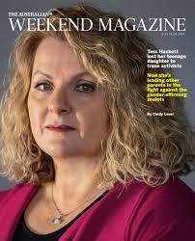
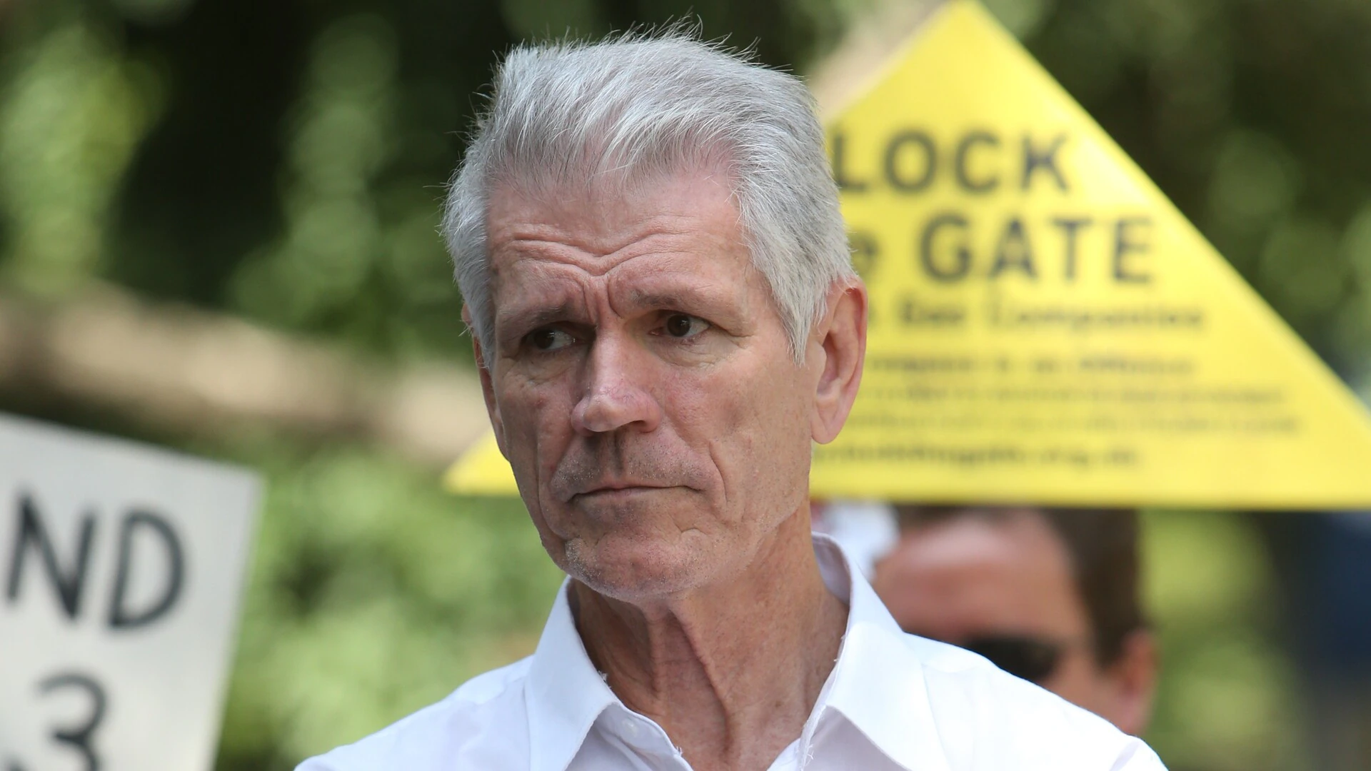
Update from Australia
Feminist Legal Clinic
WDI Conference 26 July 2025
Notes:
Hello everyone, This is a rapid update on the highlights, disappointments and outrages from Australia. Its been a busy year since my last presentation in July last year.

Slide 2


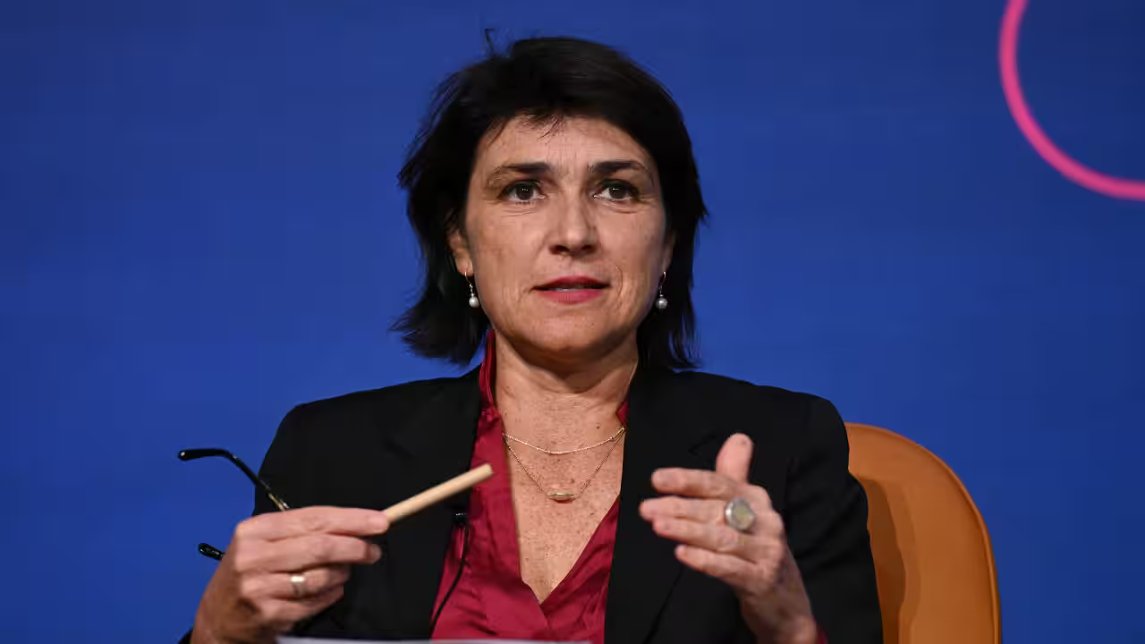
August 2024- Tickle v Giggle – no laughing matter
Tickle v Giggle decision was handed down by Justice Bromwich in the Federal Court.
Sex Discrimination Commissioner had made submissions that sex is not binary or biological and can be changed and court agrees.
The Family Court permits a 12 year old to access puberty blockers.
Notes:
The decision in the Federal Court case of Tickle v Giggle was handed down in August 2024. As you may recall this was a case where Roxanne Tickle, the man pictured on the left was refused access to an online networking app called Giggle for Girls, an app designed by Sall Grover (also pictured) to be exclusively for women.
Unfortunately Justice Bromwich of the Federal Court accepted the submissions of our Sex Discrimination Commissioner, Anna Cody (pictured at the bottom of the slide) who claims that sex is not biological, not binary and can be changed. Accordingly Justice Bromwich accepted Mr Tickle as a woman and found Sall and Giggle had acted unlawfully in excluding him from Giggle.
This is probably the most legally significant outrage of the year and we hope to see this decision overturned shortly as the appeal of this decision is about to be heard in the first week of August. However, it was by no means the only outrage of the year or even that month and I have included a couple of others from that same month, including the Australian Women’s Soccer League Title being won by a team sporting 5 biological men and also the heart breaking news of the Family Court permitting a 12 year old to access puberty blockers.

Slide 3
September 2024 – LAG Hearing before the AAT
Lesbian Action Group appears before the Australian Administrative Appeals Tribunal for a 2 day hearing.
Other outrages
Minister for Women refuses to even allow first reading of a Bill to reinstate definitions of man and woman.
Notes:
The following month of September 2025 Feminist Legal Clinic appeared on behalf the Lesbian Action Group in their case before the Australian Administrative Appeal Tribunal to challenge a decision of the Australian Human Rights Commission to refuse them an exemption to hold lesbian events free of men claiming to be women.
That month we also had the spectacle of our Federal Government through our Minister for Women, Katy Gallagher refusing to even allowing the first reading of a private members Bill to reinstate the definition of man and woman in the Sex Discrimination Act. Another low point for freedom of political expression in this country.

Slide 4

October 2024 – Greenwich’s NSW Equality Bill passes
Alex Greenwich passes his Equality Bill in NSW with the following provisions that include:
Removing the requirement of surgery to change sex on birth certificate.
Reducing constraints on pimping, surrogacy and gender affirming interventions for children.
Notes:
In stark contrast, independent NSW MPs Alex Greenwich’s so-called Equality Bill was fast tracked through parliament making extensive changes to a range of legislation, removing the requirement for surgery in order to change one’s birth certificate, easing the pathway for parental recognition of babies obtained through unlawful overseas surrogacy arrangements, making it a domestic violence offence to out someone’s transgender status and removing the remaining restraints on pimping.

Slide 5
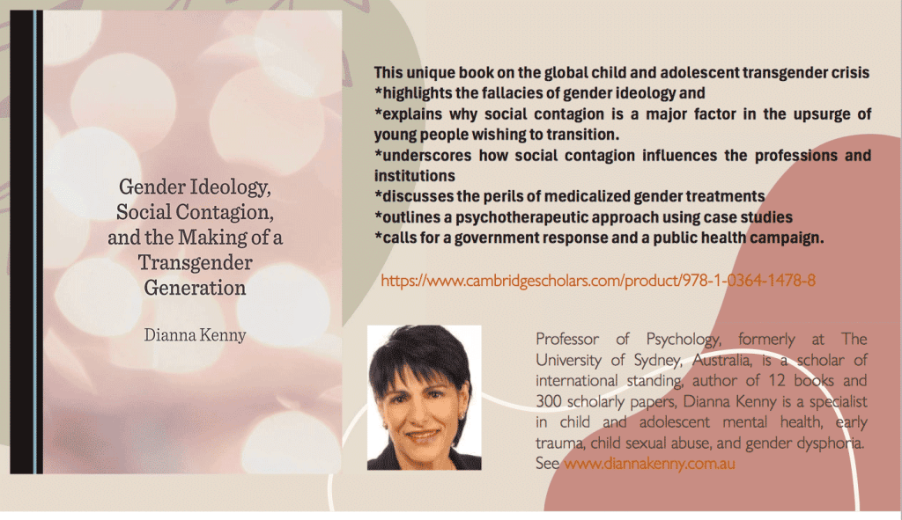
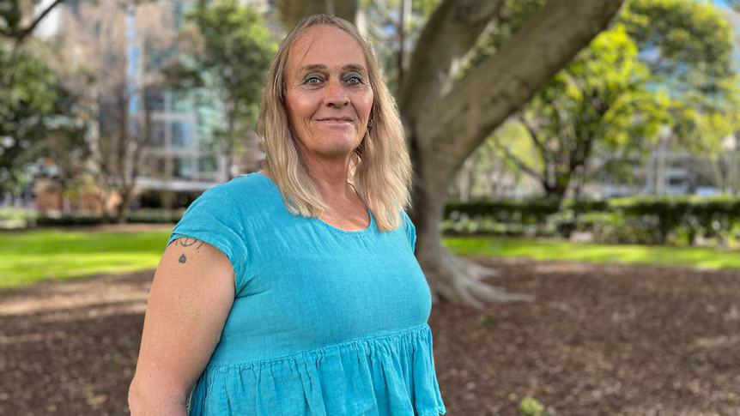
November 2024 – Dianna Kenny publishes first Australian book on child and adolescent transgender crisis
TIM settled case about being held in male prison, denied hormones while in custody.
Notes:
The outrages continued with this man in the blue dress receiving a financial settlement for having been denied access to hormones while in custody. I don’t have many details on this case but it speaks for itself.
On the positive side of things psychologist Dianna Kenny published the first Australian book and child and adolescent transgender crisis.

Slide 6

December 2024 – Moira Deeming wins case
Moira Deeming wins her defamation case against John Pessutto, the leader of the Victorian Liberal Party.
She is reinstated to the and Pesutto loses his leadership. Subsequently the Liberal Party have agreed to lend him money to pay her costs saving him from bankruptcy.
Other outrages
Family Court approves another child receiving hormones.
Notes:
However, the really happy news was when politician Moira Deeming won her case against John Pessuto, the leader of the Victorian Liberal Party who had defamed her for participating in Posie Parker’s Let Women Speak rally at Parliament House. He claimed that Ms Deeming was aligned with neo-Nazis and was unfit to serve as a parliamentarian resulting in her expulsion from the party. Ms Deeming has now been resinstated Pessuto was ordered to pay her $300,000 in damages as well as her costs. Frustratingly the Liberal Party has since agreed to lend him the costs, saving him from bankruptcy and therefore preserving his position as a parliamentarian.

Slide 7
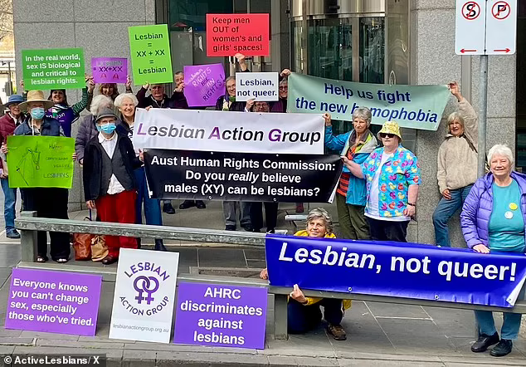
January 2025 – Lesbian Action Group lose AAT case but lodge appeal to Federal Court
Queensland announced review of Hormone Therapies for children.
Federal government also orders review of treatment guidelines for trans and gender diverse children
Outrages
Evie Amati released from prison
Family Court decision by Justice Tree
Notes:
In another disappointment, in January the Administrative Appeals Tribunal handed down its decision in the Lesbian Action Group case – again a disappointing decision that relied on the defective reasoning of Bromwich in the Tickle v Giggle case.
Axe wielding Evie Amati was released from jail on parole after 8 years despite having narrowly missed murdering several customers unfortunate enough to have been in a 7-11 when he arrived in a temper with his axe. There has been minimal reporting on this and most members of the public remain unaware that this lunatic was a male, not a woman. I am unsure whether he is maintaining his female identity, since I gather he experienced a hard time from fellow inmates in the women’s prison and had apparently asked to be transferred out of there.
There was another disappointing decision in the Family Court, this time by Justice Tree allowing yet another child to be treated with hormones. But on the positive side Queensland announced a review into the treatment of children with hormones which is currently open for submissions. The Federal Government, no doubt sensing this could hot up into an election issue, also ordered a review of the treatment guidelines for trans and gender diverse children.

Slide 8

February 2025 Man receives ‘Woman of the Year’.
Outrages
Transgender woman Brianna Skinner is handed ‘Woman of the Year’ award for Sydney by Australian state MP
A women’s rights campaigner receives apprehended violence orders in relation to a man she has never met, for objecting to his involvement in women’s soccer.
Notes:
NSW Independent MP, handed an “Woman of the Year” award to a male. Meanwhile women campaigning to retain sex-based rights are increasingly pursued legally with trans activists seeking apprehended violence orders to silence them. These laws originally designed to protect women from male violence are increasingly now weaponized against them by men.

Slide 9

March 2025 – Win against eSafety Commissioner
Several wins against eSafety Commissioner
Baumgarten and eSafety Commissioner (Guidance and Appeals Panel)
Notes:
However, we had some good news again in March with our eSafety Commissioner being suitably admonished in several cases, for using unlawful means to issue take down notices to those who used social media to question, gender ideology. Those who received her dodgy notices had commited transgressions like questioning having a queer club in a primary school or stating that men can’t breastfeed. Fotrtunately ,for us all Elon Musk has the deep pockets necessary to challenge this kind of oppressive conduct.

Slide 10
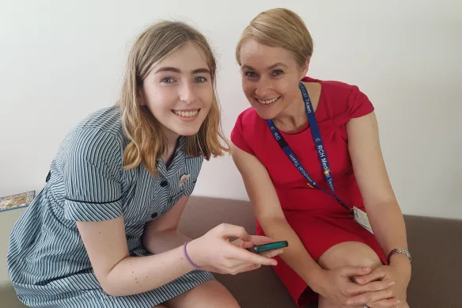
April 2025 –Family Law case Re Devin - reality check
Family Court ruling by Justice Strum ruptured gender ideology and admonishes leading gender affirming doctor Michelle Telfer.
Outrages
Anti-conversion therapy laws are rolled out
Notes:
In April 2025, we had another significant breakthrough with a Family Court judge finally bucking the trend and refusing to approve the treatment of a child with hormones and instead admonishing Michelle Telfer the expert witness being relied upon in the mother’s case and also a much lauded key doctor responsible for drafting guidelines and generally advancing the trans agenda in Australia. Finally steps are being taken to hold her accountable for her role in this scandal with complaints referring her to the appropriate regulatory body.

Slide 11
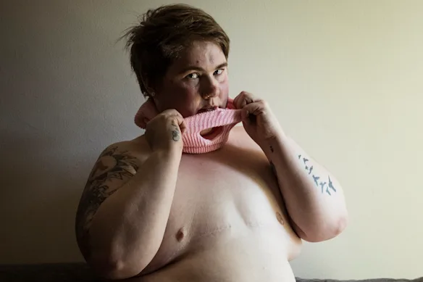

May 2025 – Detransitioner Mel Jeffries sues doctors
Other outrages:
Notes:
In May, medical negligence proceedings were commenced on behalf of detransitioner Mel Jefrries who is suing her doctors for the physical and psychological harm she has suffered. Her story has received significant media coverage and Mel continues to campaign strongly to raise awareness of the shocking risks involved not only for children but also vulnerable young adults such as herself with unaddressed histories of trauma and co-morbidities.

Slide 12

June 2025 – Lesbian Action Group granted leave to intervene in Giggle v Tickle Federal Court appeal
Notes:
Last month the big news was that the Lesbian Action Group have been granted leave to intervene in the Giggle v Tickle Federal Court appeal case. So this is going to be a very significant case legally for Australians and we will be watching it closely. I understand it will also be live streamed on the court’s You Tube channel.

Slide 13
July 2025 – Founder of Australian Greens goes public with concerns of Party takeover by transgender cult
The Australian newspaper
has covered how families have been destroyed by gender ideology.
Other news
Jereth Kok result
UPR Shadow Report
Desexing society podcast
Drew Hutton, co-founder of the Australian Greens has gone public with his concerns about the party and has been expelled as a result.
Notes:
Finally we come to this month which has also seen some significant developments with a co-founder of the Australian Greens speaking out publicly about his concerns about the capture of the party by a transgender cult. This has resulted in his expulsion from the Greens which is now garnering further publicity. His actions in going public have seen the story gain momentum with The Australian newspaper profiling other Greens members who have been expelled on this account including myself. I was pleased to recently have the story of my expulsion from the party over this issue finally receiving some more extended coverage.
The Australian newspaper has also run a big articles describing the distressing experiences of parents of children who have been effectively taken by the cult, such as Tess Hackett who featured on the cover of their Weekend magazine.
I have really just skimmed the surface of all the cases and events here in Australia relating in relation to this bizarre global scandal. I think you can see why we have been busy just following events as they unfold.

